Slide 1
RSA Algorithm
- Given By Rivest–Shamir–Adleman in 1997

Slide 2
Content
RSA Introduction
Types of Encryption
Flow of RSA
Key Generation in RSA
Encryption
Decryption
Example of RSA
Security Consideration in RSA
Attacks on RSA
Applications
Advantages & Disadvantages of RSA

Slide 3
INTRODUCTION
RSA algorithm is an asymmetric cryptography algorithm.
The RSA algorithm is based on public-key encryption technology .
Best known and widely used public key scheme.

Slide 4
Types of Encryption
Symmetric Key Encryption
Asymmetric Key Encryption

Slide 5
Symmetric Key Encryption
In Symmetric-key encryption the message is encrypted by using a key and the same key is used to decrypt the message which makes it easy to use but less secure.

Slide 6
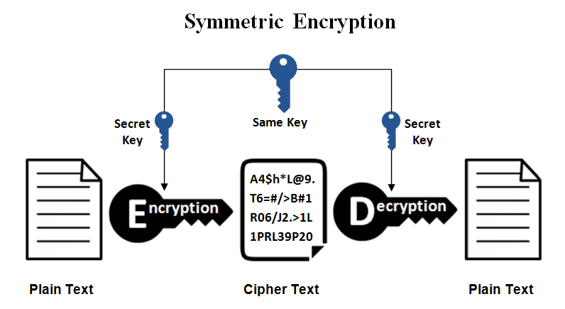
Flow of Symmetric Key Encryption

Slide 7
Asymmetric Key Encryption
Asymmetric Key Encryption is based on public and private key encryption techniques. It uses two different key to encrypt and decrypt the message. It is more secure than the symmetric key encryption technique but is much slower.

Slide 8
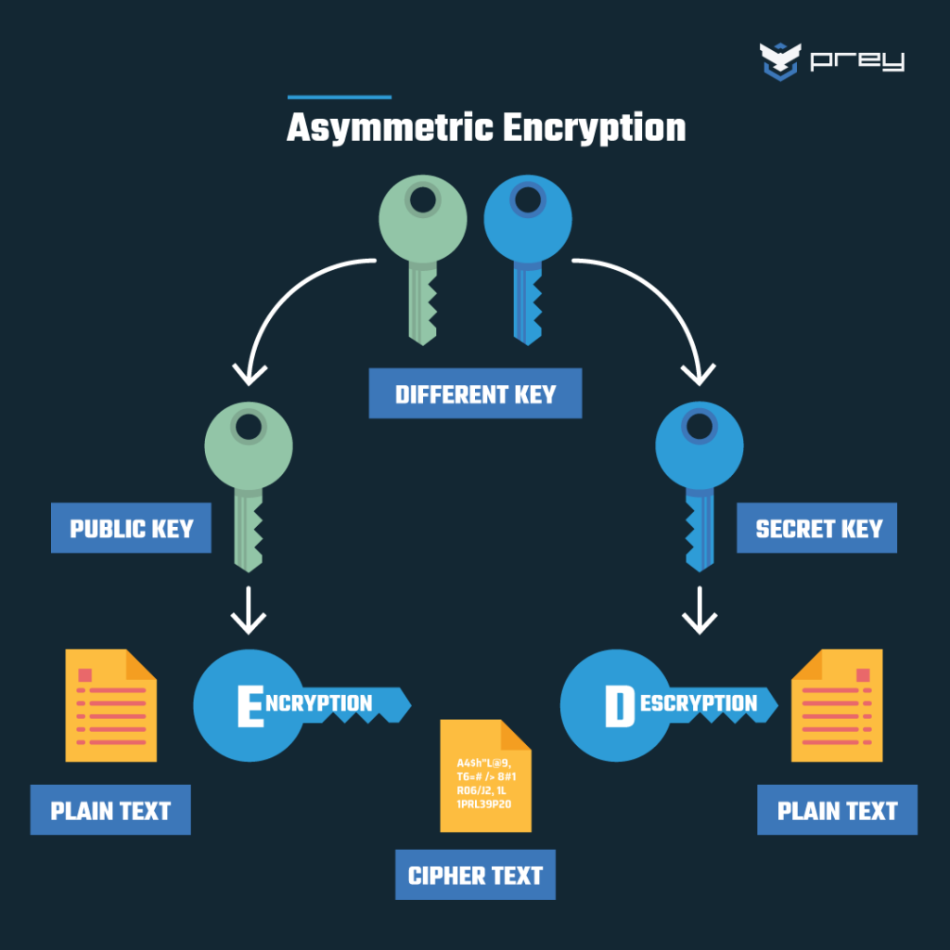
Flow of Asymmetric Key Encryption

Slide 9
Flow of RSA
A client (for example browser) sends its public key to the server and requests some data.
The server encrypts the data using the client’s public key and sends the encrypted data.
The client receives this data and decrypts it using it’s own private key.

Slide 10
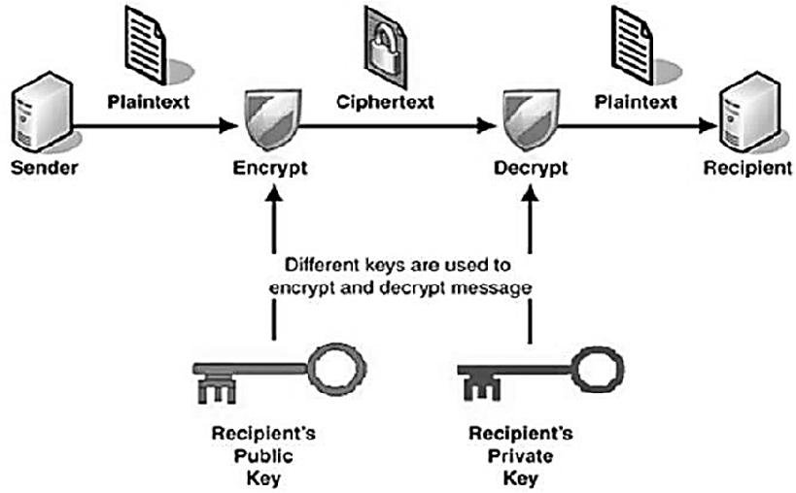
Flow of RSA

Slide 11
Key Generation in RSA
Choose two large prime numbers (p and q)
Calculate n = p*q and φ(n) = (p-1)(q-1)
Choose a number e where 1 < e < φ(n)
Calculate (d * e) ≡ 1 (mod φ(n))
You can bundle public key pair as (n,e)
You can bundle private key pair as (n,d)

Slide 12
Encryption process in RSA
1. Message Encoding
The message is encoded into a numerical representation suitable for RSA encryption.
Public Key Encryption
The encoded message is raised to the power of the public exponent and modulo the public modulus to produce the ciphertext.
3. Ciphertext Transmission
The encrypted message (ciphertext) can be safely transmitted to the recipient over an insecure channel.

Slide 13
Decryption Process in RSA
Ciphertext Reception
The recipient receives the ciphertext and prepares for decryption.
2. Private Key Decryption
The ciphertext is raised to the power of the private exponent and modulo the private modulus to recover the original message.
3. Message Decoding
The decrypted numerical representation is converted back into a human-readable message.

Slide 14
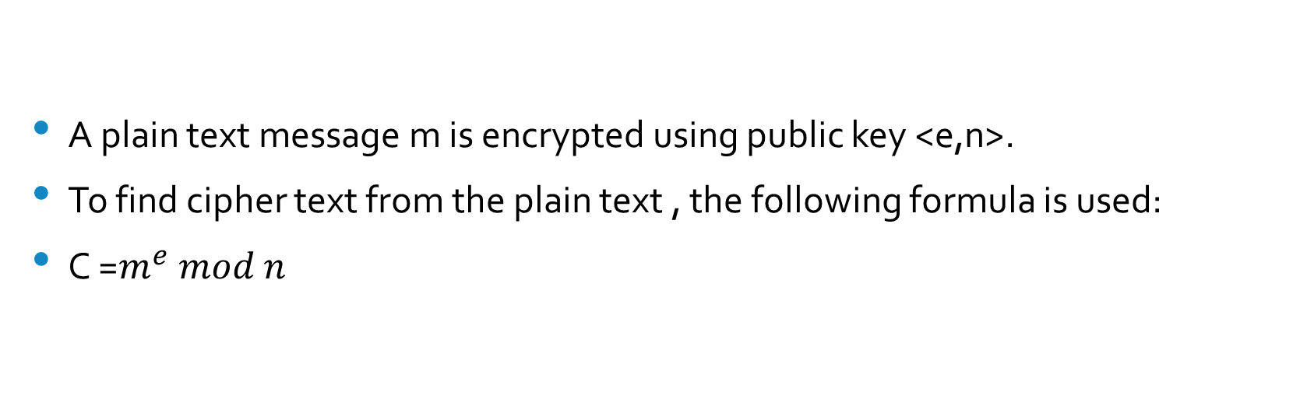
Encryption Algorithm
A plain text message m is encrypted using public key <e,n>.
To find cipher text from the plain text , the following formula is used:
C =$m^{e} mod n$

Slide 15
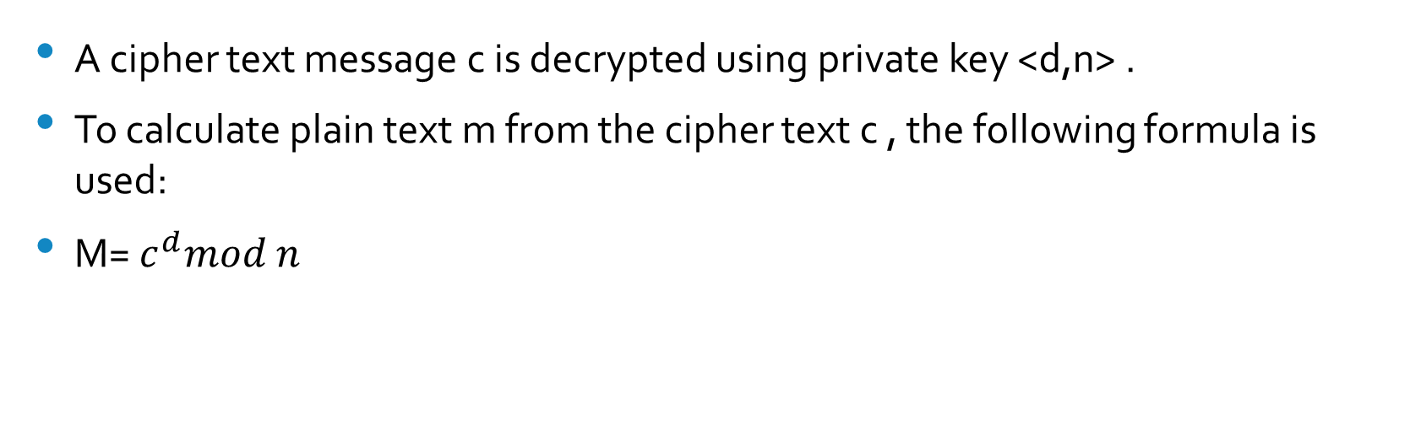
Decryption Algorithm
A cipher text message c is decrypted using private key <d,n> .
To calculate plain text m from the cipher text c , the following formula is used:
M= $c^{d}mod n$

Slide 16
Example of RSA
This example uses prime numbers 3 and 11 to generate the public and private keys.
Explanation:
Step 1: Choose p = 3 and q = 11
Step2: Compute n = p * q = 3 * 11 = 33
Step3: Compute φ(n) = (p - 1) * (q - 1) = 2 * 10 = 20
Step4: Choose e such that 1 < e < φ(n) and e and φ (n) are coprime. Let e = 7

Slide 17
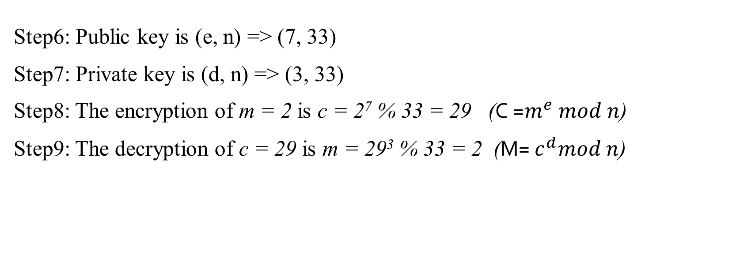
Step5: Compute a value for d such that (d * e) % φ(n) = 1. One solution is d = 3 [(3 * 7) % 20 = 1]
Step6: Public key is (e, n) => (7, 33)
Step7: Private key is (d, n) => (3, 33)
Step8: The encryption of m = 2 is c = 2⁷ % 33 = 29 (C =$m^{e} mod n$)
Step9: The decryption of c = 29 is m = 29³ % 33 = 2 (M= $c^{d}mod n$)

Slide 18
Attacks on RSA
Plain Text Attack
Chosen Cipher Attack
Factorization Attack

Slide 19
Plain text attacks
Short message attack : In this we assume that attacker knows some blocks of plain text and tries to decode cipher text with the help of that. So, to prevent this pad the plain text before encrypting.
Cycling attack: In this attack, the attacker thinks that the cipher text has been generated by using some permutation. He uses all possible permutations of plain text to decipher the cipher text by ‘cycling’ the permutations.
Unconcealed Message attack: Sometimes it happens that plain text is same as cipher text after encryption. So it must be checked or it will be of no use as the attacker will see right through it.

Slide 20
Chosen cipher attack
In this attacker is able to find out plain text based on cipher text using the Extended Euclidean Algorithm.

Slide 21
Factorization attack
If the attacker is able to know P and Q using N, then he can find out value of private key. This fails when N contains at least 300 longer digits in decimal terms, attacker will not able to find it.

Slide 22
Real-World Applications of RSA
Secure Online Transactions
Digital Signatures
Virtual Private Networks (VPNs)

Slide 23

Secure Online Transactions
RSA is widely used to secure online transactions, such as e-commerce and online banking, ensuring privacy and data integrity.

Slide 24
Digital Signatures
A digital signature is a cryptographic output used to verify the authenticity of data.
A signing operation, which uses a signing key to produce a signature over raw data.
A verification operation, where the signature can be validated by a party who has no knowledge of the signing key.

Slide 25
Digital signing workflow using RSA
The signer creates an asymmetric key that supports digital signing.
The signer can use this key to create multiple signatures.
The signer performs a private key operation over the data to create a digital signature
The signer provides the data and the digital signature to the data recipient.
The recipient uses the public key portion of the signer's public/private key pair to verify the digital signature. If verification is unsuccessful, then the data has been altered.

Slide 26
Virtual Private Networks (VPNs)
RSA helps establish secure VPN tunnels, allowing remote employees to access corporate networks safely and securely.
On putty you can give the public key for authentication so that you can manipulate the files on that server. These are mainly used by developers to give support to their client. They take the public key from client and do the required modification to communicate with the server. RSA is the first algorithm which supported secure communication without a shared key where the encryption is easy and decryption is hard without the private key.

Slide 27
ADVANTAGES
Security: RSA algorithm is considered to be very secure and is widely used for secure data transmission.
Public-key cryptography: RSA algorithm is a public-key cryptography algorithm, which means that it uses two different keys for encryption and decryption. The public key is used to encrypt the data, while the private key is used to decrypt the data.
Key exchange: RSA algorithm can be used for secure key exchange, which means that two parties can exchange a secret key without actually sending the key over the network.

Slide 28
DISADVANTAGES
Slow processing speed: RSA algorithm is slower than other encryption algorithms, especially when dealing with large amounts of data.
Large key size: RSA algorithm requires large key sizes to be secure, which means that it requires more computational resources and storage space.
Limited use in some applications: RSA algorithm is not suitable for some applications, such as those that require constant encryption and decryption of large amounts of data, due to its slow processing speed.

Slide 29
THANK YOU!!

